Slide 1

A Patch Distribution Modeling Framework for Anomaly Detection and Localization
Paper review
Gibeom Kim (UST)

Slide 2
1. Paper abstract
By using pre-trained CNN models and Gaussian Distribution for anomaly detection in images
The features obtained by passing training images through the CNN model are computed for Mahalanobis distance on a patch-by-patch.
Extraction of feature values from all layers of the CNN model to consider correlations at different semantic levels.
Each patch is assumed to follow a Multivariate Gaussian Distribution.

Slide 3
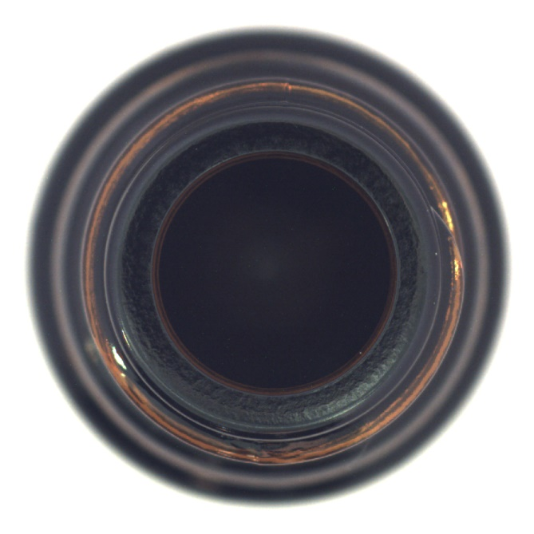
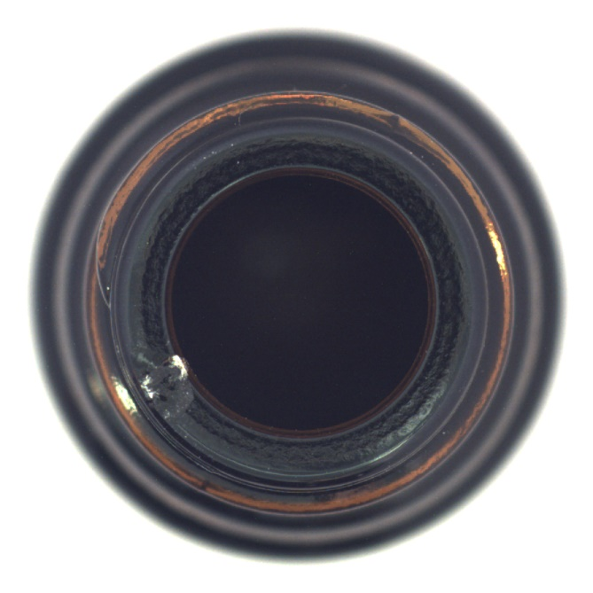
1-1. Anomaly detection
Anomaly Detection
Train a model using only normal images and then determine whether a given image is normal or abnormal.
In industrial site, it is easy to obtain normal images, but difficult to acquire abnormal images.
Normal image
Abnormal image

Slide 4

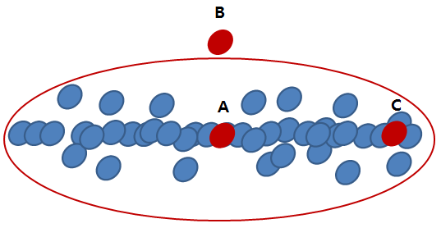
1-1. Terminology Explanation
Mahalanobis Distance
Distance in Probability Distributions
A value indicating the number of standard deviations a data point is from the mean of the distribution.
x: Individual data values
μ: Mean of the data values
S: Covariance matrix of the data

Slide 5
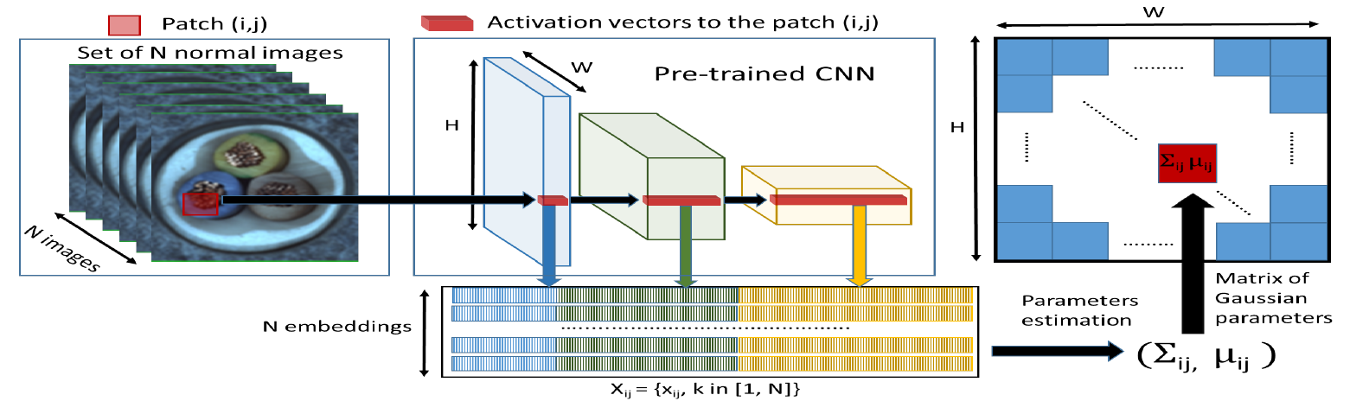
1. Paper Abstract

Slide 6
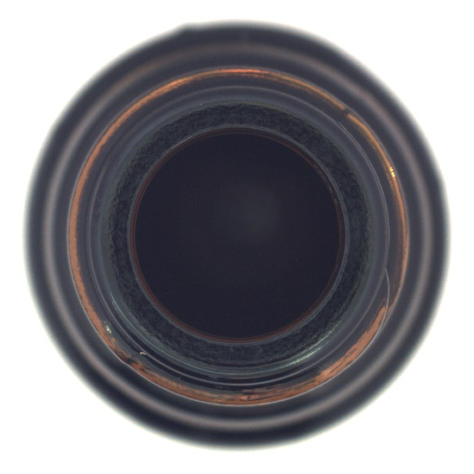






1. Paper Abstract

Slide 7
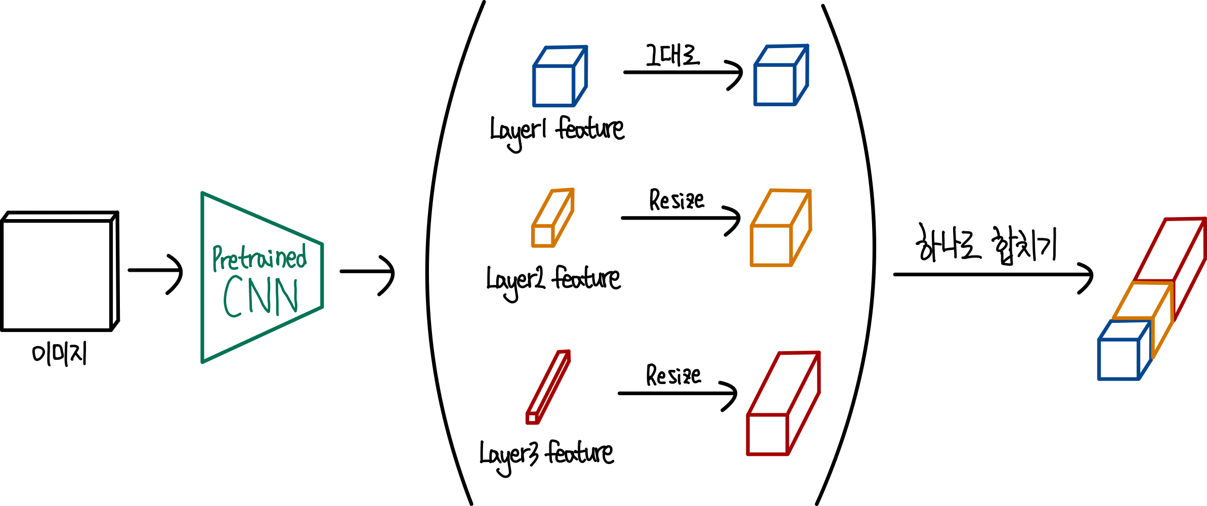
2. Model
Embedding extraction
Concat all features extracted from pre-trained CNN layers to a single embedding vector

Slide 8
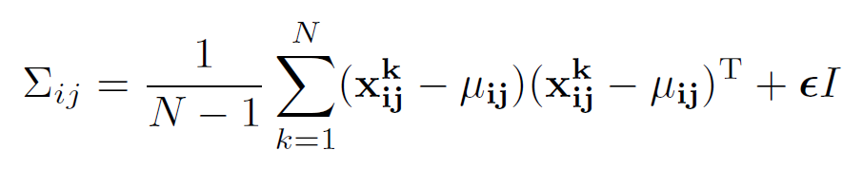

2. Model
Learning of the normality
This process is not actual deep learning training but rather a step to compute the Mahalanobis distance for each patch, involving the calculation of the covariance of the normal data patch features
$$x_{ij}^{k}:The patch embedding vector corresponding to position \left(i, j\right)$$
$$in the k-th training image.$$
$N:The total number of normal training images.$
$μ_{ij}:The mean of X_{ij}, which is the average of the embedding vectors$ $for all training images at position \left(i, j\right).$
$Σ_{ij}:The covariance matrix of$ $X_{ij}$
$εI:A regularization term that ensures the covariance matrix is$ $full rank, allowing the calculation of the inverse matrix.$

Slide 9
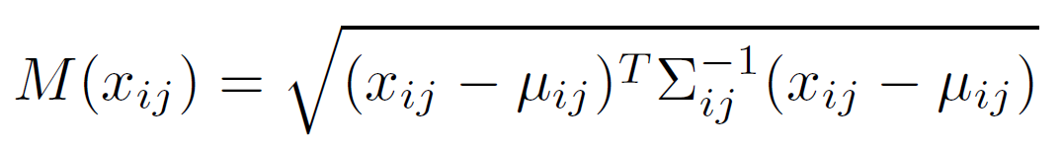

2. Model
Inference : computation of the anomaly map
Test images are input into the pre-trained CNN model in the same method as the previous process.
The Mahalanobis distance is then calculated to compare how far each patch is from the mean and covariance values of the normal images on a patch-by-patch.
$$x_{ij}:The patch embedding vector corresponding to position \left(i, j\right)$$
$μ_{ij}:The mean of X_{ij}, which is the average of the embedding vectors$ $for all training images at position \left(i, j\right).$
$Σ_{ij}:The covariance matrix of$ $X_{ij}$
$M\left(x_{ij}\right):The Mahalanobis distance for the patch embedding vector$
$$at position (i, j) in the test image.$$

Slide 10
감사합니다

